Slide 1

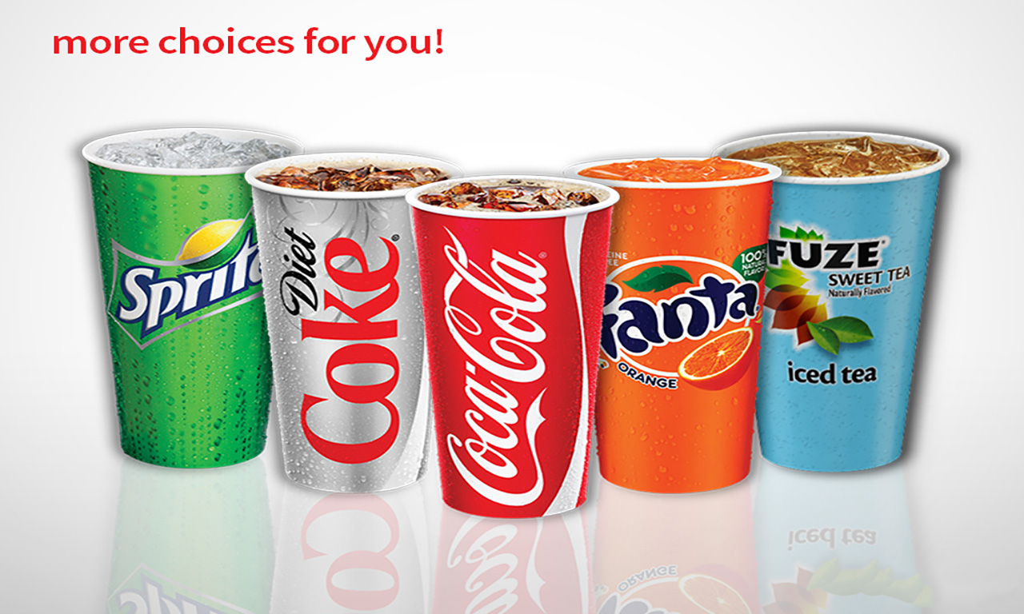



BEVERAGES
DAILY SPECIAL
 | SMALL | Regular
COCACOLA DRINKS 0-380 Cal | 1.69 | 1.99
LEMONADE 165 Cal
BOTTLED WATER 0 Cal |  | 1.49
BOTTLED DRINK 10-230 Cal |  | 2.29
Chicken Teriyaki
640 Cal
6.69
6.39
SERVED WITH: • Mixed Vegetables • Steamed Rice
Extra Chicken
(4 oz.) 170Cal
1.69

Slide 2
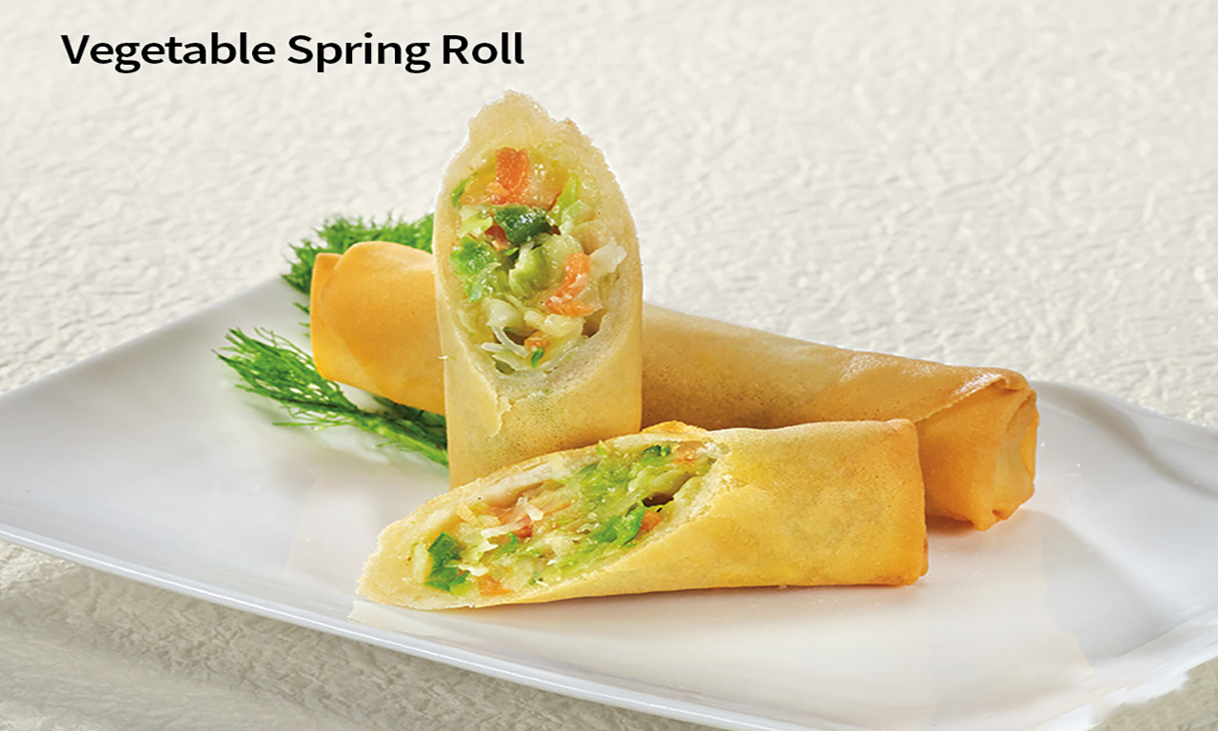
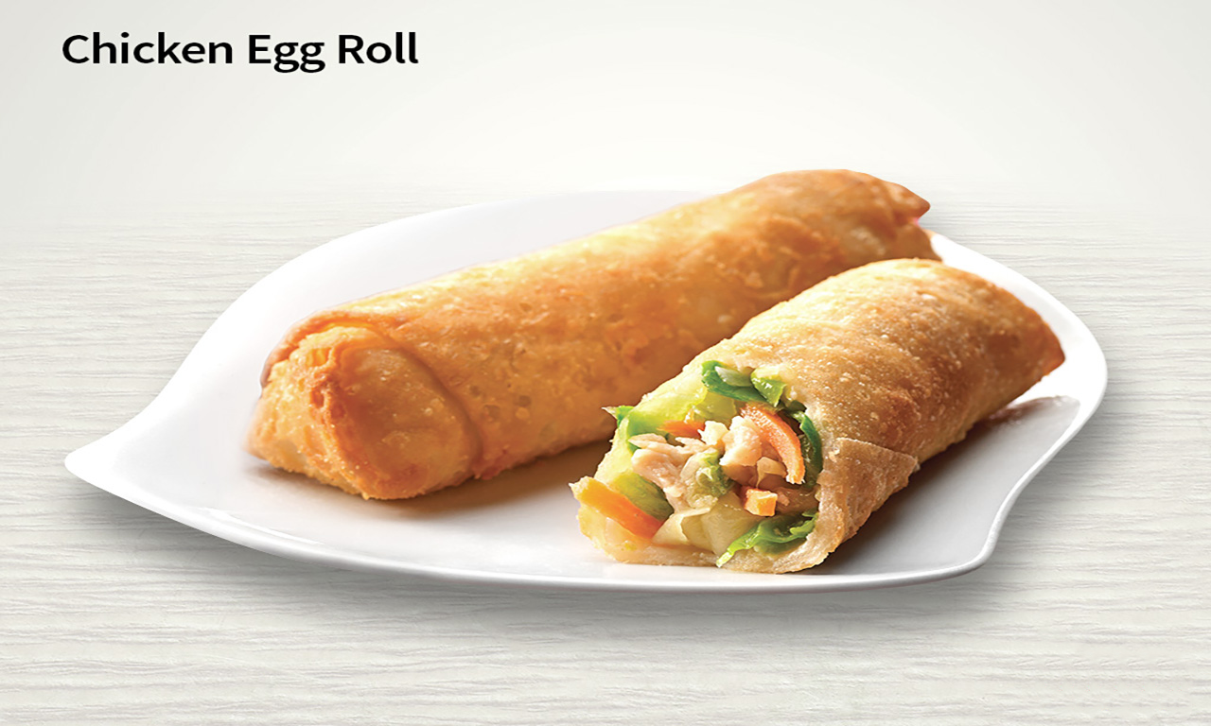
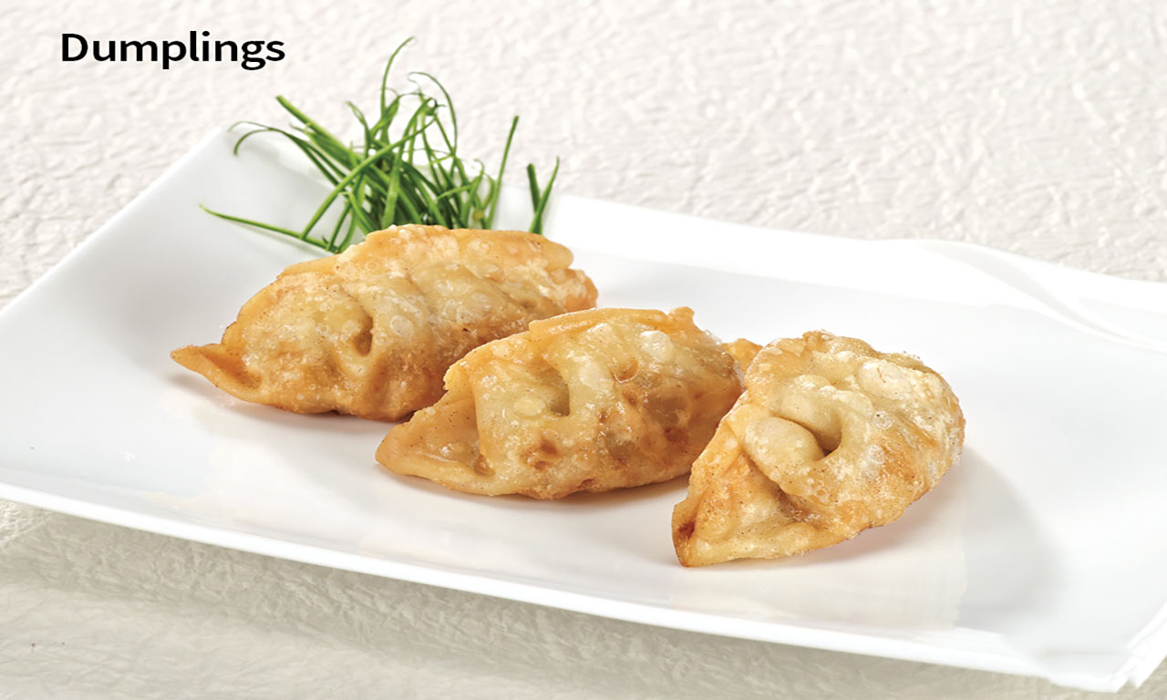
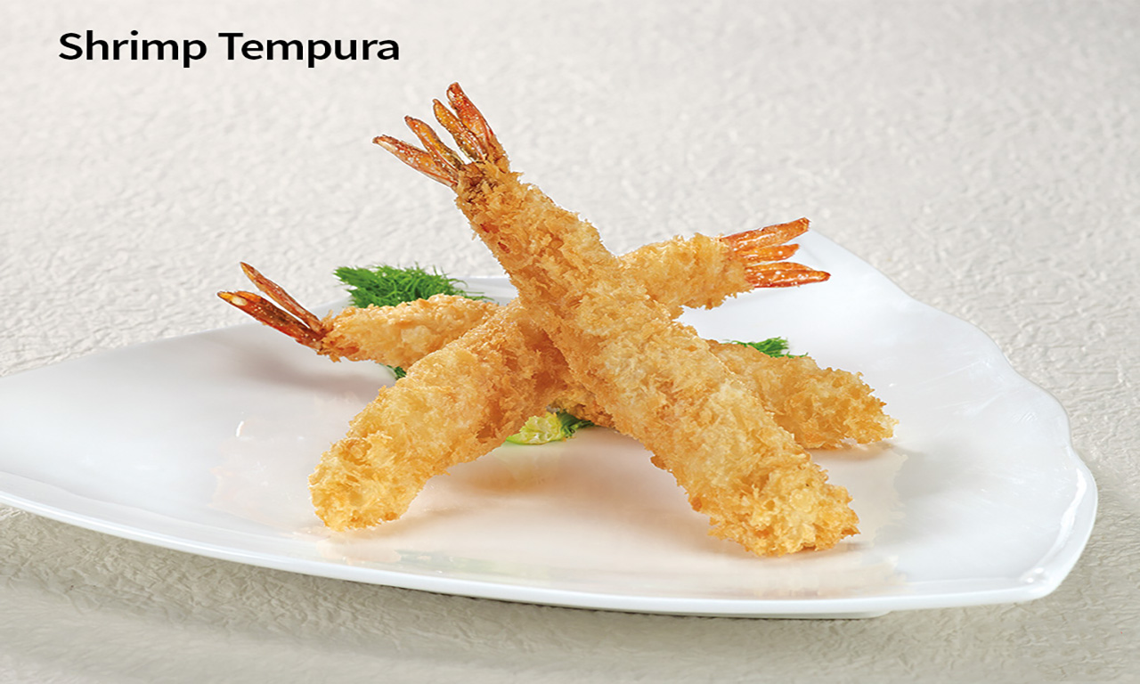
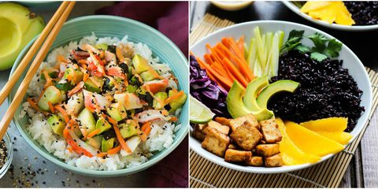
SIDE ORDERS
D’LITE MEAL

Slide 3
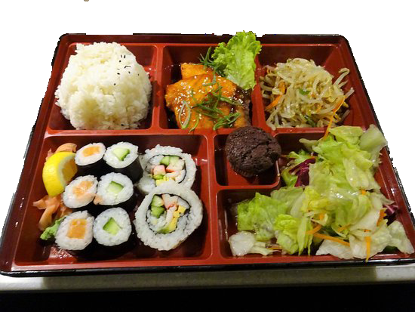
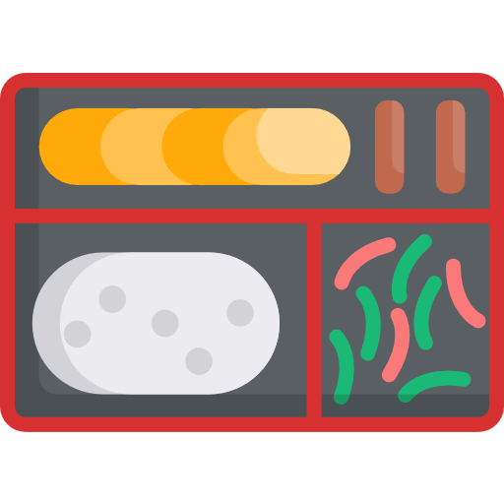


BENTO BOX
Chicken Bento | 930 Cal 8.19
Beef Bento | 810 Cal 8.99
Shrimp Bento | 750 Cal 9.49

Slide 4
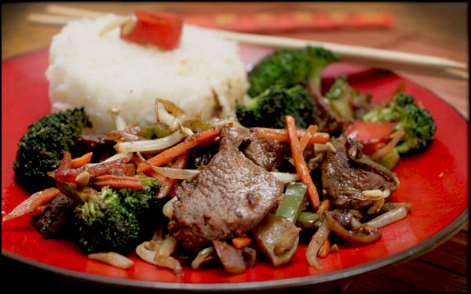
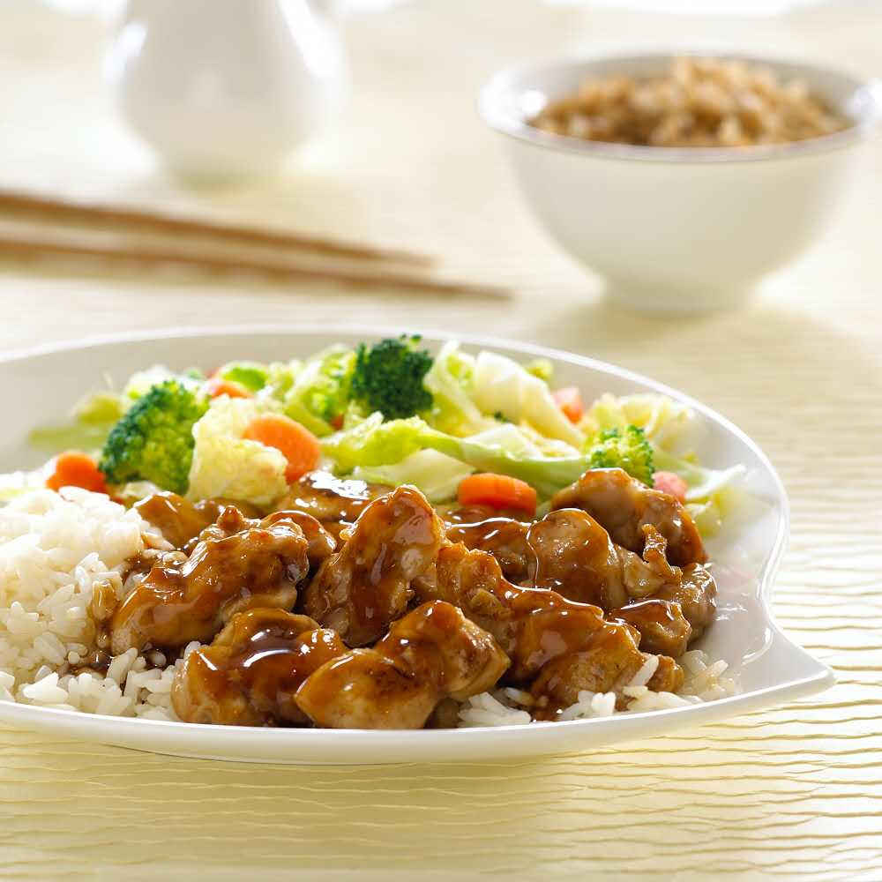
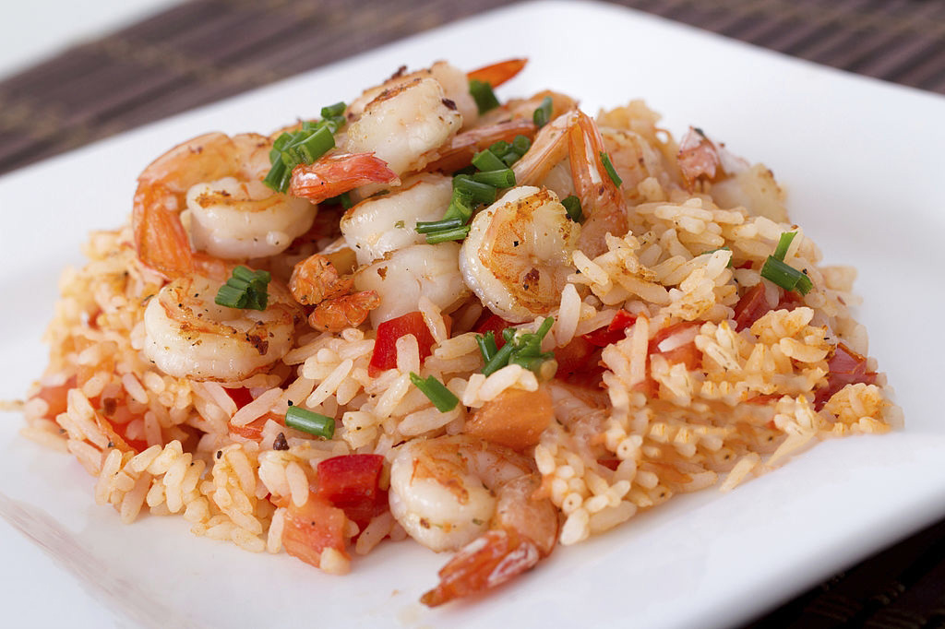

TERIYAKI
SERVED WITH: • Steamed Rice • Mixed Vegetables
1
2
3
4
5

